Slide 1
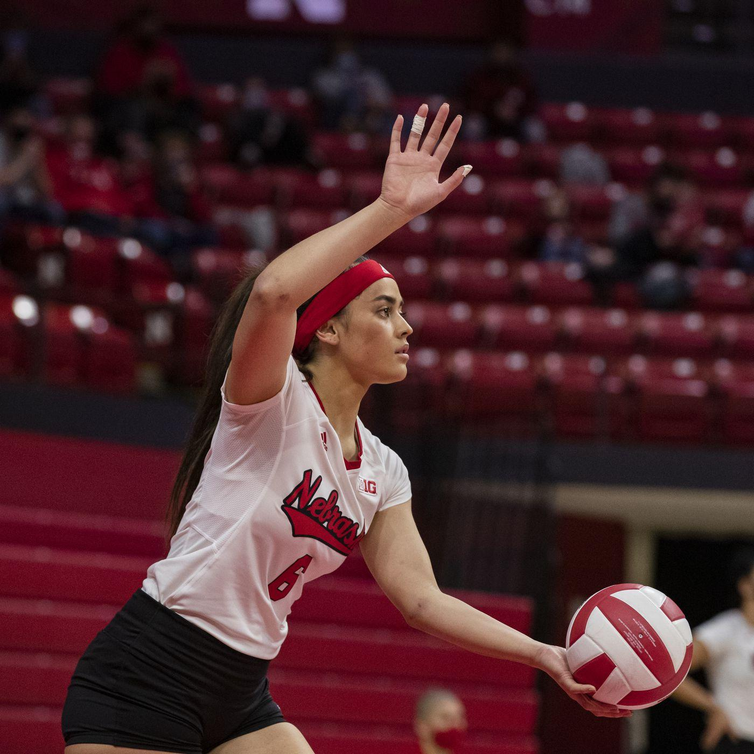
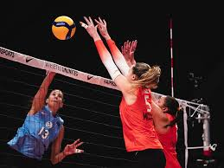
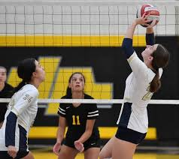
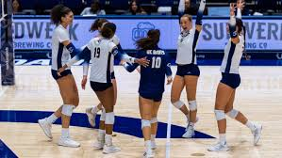
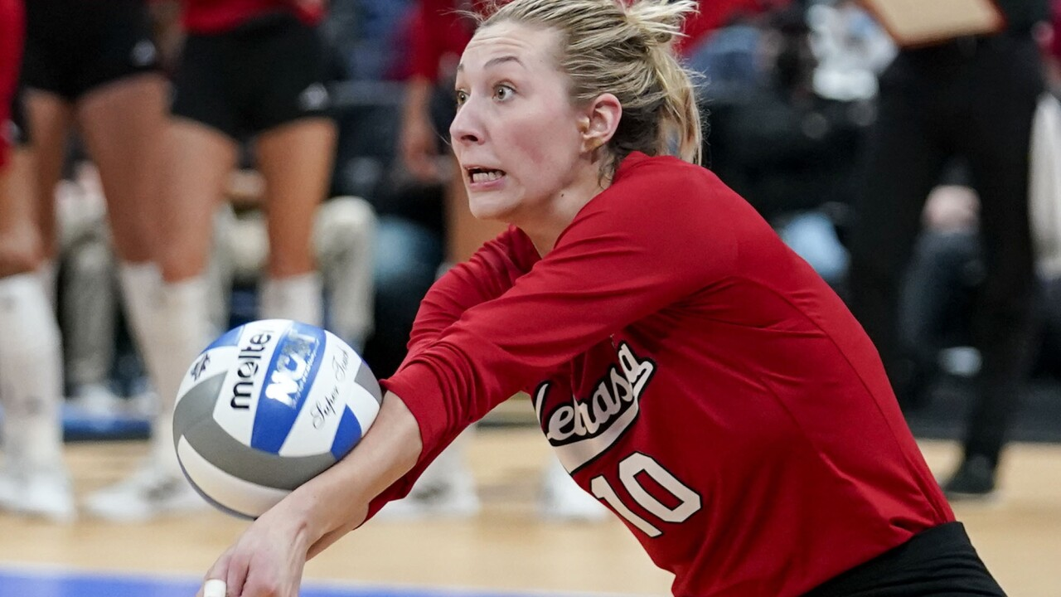
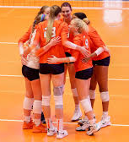
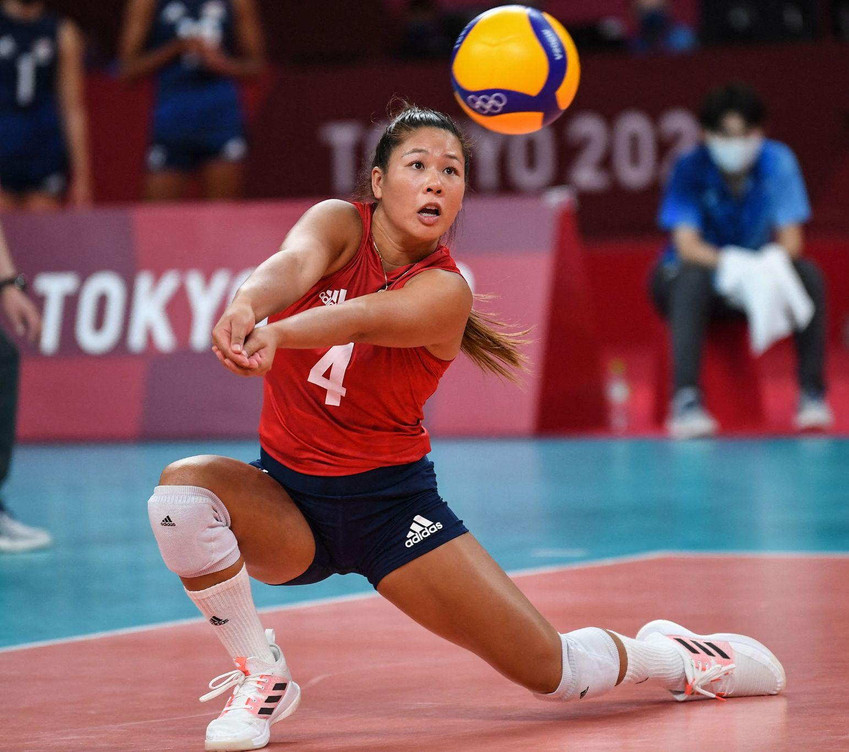
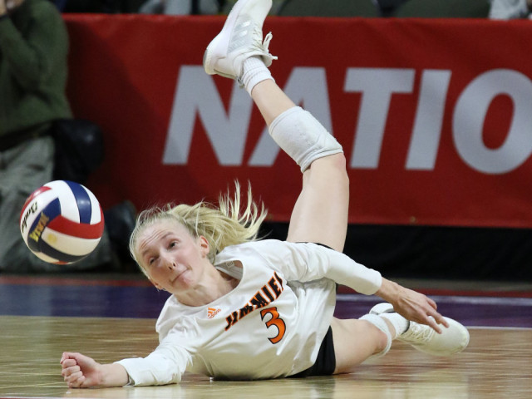
Volleyball:
Basic Rules, Positions/Roles,
Skills,&
Resources
Ben Steele Middle School
Volleyball
2022-2023
Coach Anica Knispel

Slide 2
Table of Contents
Basics
Rules, Violations, Scoring, Rotations, Base
Positions/Roles
Setters (S), Hitters (OH, MB,RS or OP), and Passers (DS,Libero)
Skills
Passing/Digging, Setting, Hitting/Attacking, Serving
More Resources!
Skills and Drills, Rotations, Watching Volleyball

Slide 3
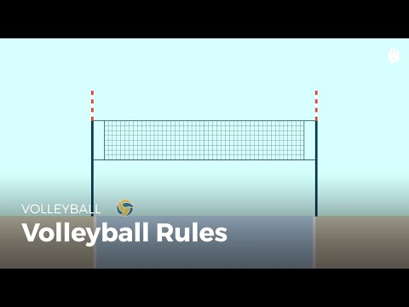
Basics: Rules
Key Points to Remember:
6 on 6
Ball can touch the net, but YOU can’t
Point earn when
drops in the court on other side
other team makes an error/violation
Starts with serve
Rotate clockwise once your team earns the serve BACK from the other team

Slide 4
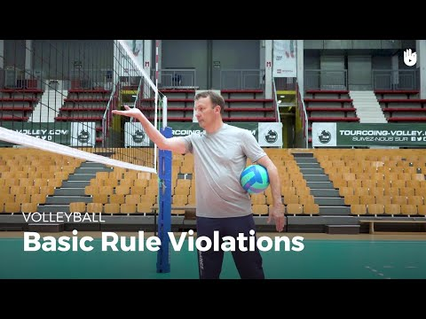
Basics: Violations
Key Points to Remember:
Playing Violations
Serve/Hit
in/under net
outside of antennas
outside of court boundaries
More than 3 contacts
Ball hits inside court
Technical Violations
Serving/Center Line
Net Violations
Contacts
Doubles,
Carries,
Rotational
Rotate Clockwise for equal play

Slide 5
Basics: Scoring
Key Points to Remember:
Rally Scoring
Either the Serving Team or the Receiving team can earn the point
Best 2 out of 3
Sets 1-2: to 25
Set 3: 15
Win by 2
Side Out
When the receiving team needs to earn the point out of serve receive to get the serve
only way to earn lots of points back to back is when you have the serve

Slide 6
Basics: Rotations
Key Points to Remember:
Overlapping
Have to be in between the players from your left and right
Have to be either in front or behind of the person directly in line with you
Out of Rotation
Unfair advantage
Results in loss of serve and other team gets a point

Slide 7
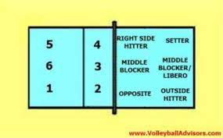
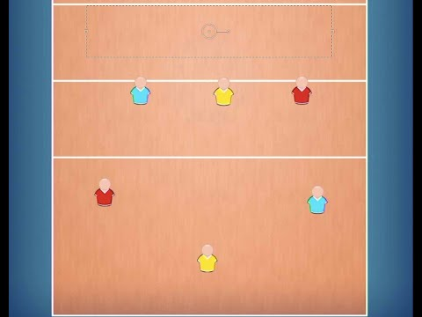
Basics:
Base/Defense
Key Points to Remember:
Base
AFTER the ball has been served
where you go after the ball has been sent to the other team
Positions:
Setters/DS1: Position 1/2
Middles/DS6: Position 6/3
OH/DS5: Position 5/4

Slide 8
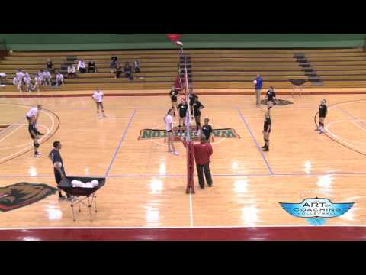
Basics:
Free/Offense
Key Points to Remember:
Free/ Offense
AFTER the ball has been served
where you go after you defend the first ball and set up your offense
Positions:
Setters: Position 2/3
Hitters: 10ft Line
DS/Libero: Covering

Slide 9
Table of Contents
Basics
Rules, Violations, Scoring, Rotations
Positions/Roles
Setters (S), Hitters (OH, MB,RS or OP), and Passers (DS,Libero)
Skills
Passing/Digging, Setting, Hitting/Attacking, Blocking, Serving
More Resources!
Skills and Drills, Watching Volleyball

Slide 10
Positions:
Setters
Key Points to Remember:
Lead the Offense
Plan out hitting options
Note weaknesses in opponent’s defense
MAKE YOUR HITTERS LOOK GOOD!
Front vs Back Setters
Front:
can attack the ball over the net and jump
can set OH, M in all 3 spots
must block and play off-blocker defense
Back:
can’t attack or jump
set OH, M, and RS
must play D1 before setting

Slide 11
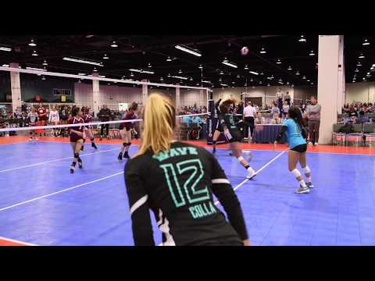
Positions:
Outside Hitters
Key Points to Remember:
Offensively
Hit out of 4
Expected to hit the messy sets
Have more area to hit
Defensively
Serve receive
Block setter attacks
Block M & RS attacks
Off-Blocker Defense
If not blocking, PASSING

Slide 12
Positions:
Middles
Key Points to Remember:
Offensively
ALWAYS GO! Even if you don’t get set “DECOY”
Slow down their blockers to open up for your pin hitters (OH/RS)
Approach/attack between blockers
Defensively
Blocking EVERY Hitter
Free Ball Transition
Transition to pass your ball (10ft line)

Slide 13
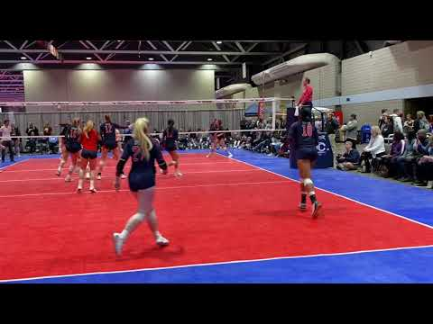
Positions:
DS/Libero
Key Points to Remember:
Defensive Specialist
Sub in for 1 player
Can attack behind line
GOAL: get EVERY ball to setter and playable
Serve Receive
Defense
Free Ball
Covering Hitters
Libero
Can go in for anyone in the back row; NO SUB
Can only serve for 1
Can set but only behind the 10ft line
Leader of the defense
Tells hitters and setter what is open
Can play almost entire time

Slide 14
Table of Contents
Basics
Rules, Violations, Scoring, Rotations
Positions/Roles
Setters (S), Hitters (OH, MB,RS or OP), and Passers (DS,Libero)
Skills
Passing/Digging, Setting,(Serve Receive), Hitting/Attacking, Blocking, Serving
More Resources!
Skills and Drills, Watching Volleyball

Slide 15
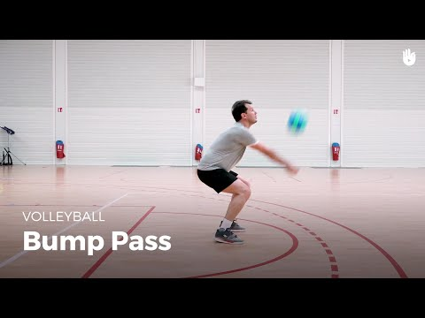
Skills:
Passing
Key Points to Remember:
Movement
Hands apart,
Stepping to get behind the ball
shuffle or cross step
Position
Shoulders forward over knees
Arms together away from body
Contact
Don’t swing shoulders; shrug
Point platform towards target

Slide 16
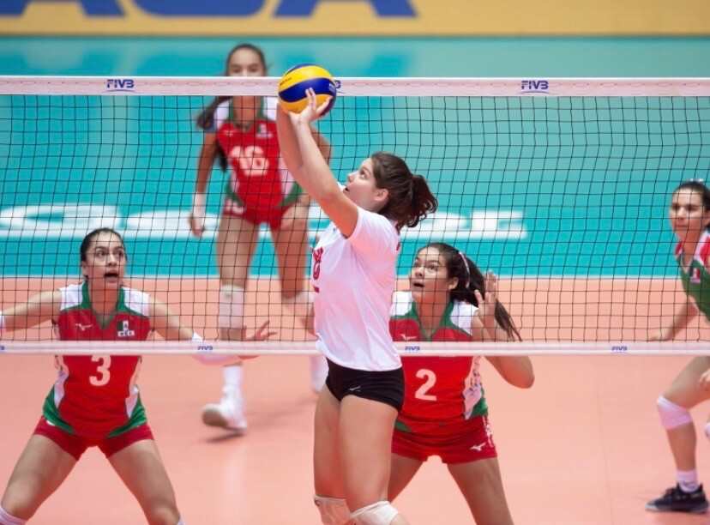
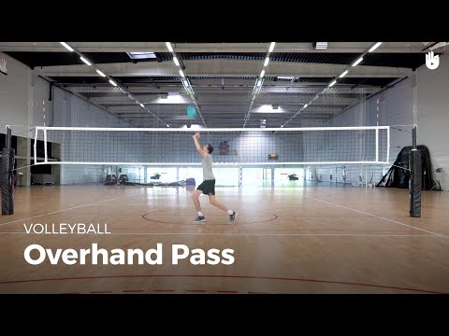
Skills:
Setting
Key Points to Remember:
Movement
Hands apart,
Stepping to get behind and slightly under the ball
run, “right-left” stance
Position
Arms bent, hands at eye level
Toes, hips, shoulders ALL facing towards target
Jump before making contact with ball
Contact
Round hands to “catch” ball on fingers
Push ball out by extending arms

Slide 17
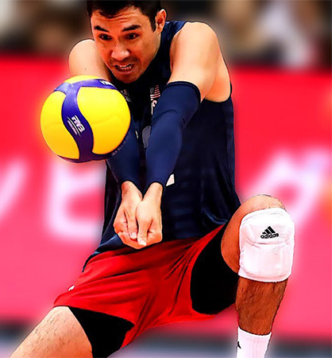
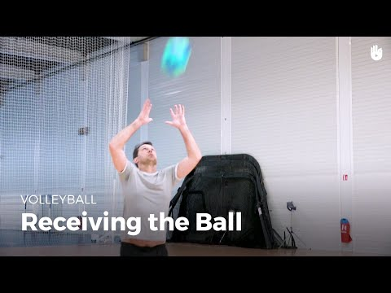
Skills:
Serve Receive
Key Points to Remember:
Forearm Passing
Slow down the ball by absorbing
Point platform towards setter to set up offense
Setting
Cut off the ball’s trajectory by moving in line with the ball
Follow through towards the setter spot to set up offense

Slide 18
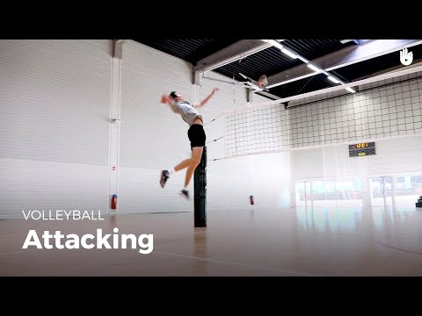
Skills:
Hitting/Attacking
Key Points to Remember:
“Movement” Phase
Start behind the 10ft line
Fall into sprint towards the ball
Load Phase: 2-Step into squat; toes NOT straight on
“Jump” Phase
Use arms to project you up
Draw back hitting arm
Create seperation from shoulders and hips
Track with opp. hand
“Contact” Phase
Hand on top of ball
Snap Wrist (“hand in cookie jar”)
Pull arm through
“Landing” Phase
Land on 2 feet away from net

Slide 19
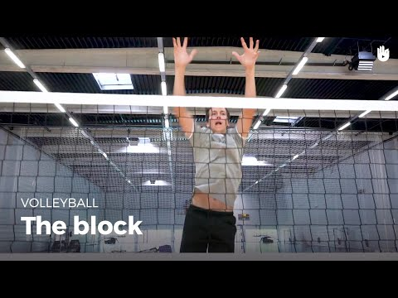
Skills:
Blocking
Key Points to Remember:
“Ready Stance” Phase
Arm Distance away from net
Bent knees ready to jump or move
Watching offense
“Movement” Phase
Move towards attacker
Shuffle/approach
Minimize steps
Keep distance from net
“Jump”
Use arms to jump
PIKE around net
Goal:
slow down attack
minimize attackers hitting options

Slide 20
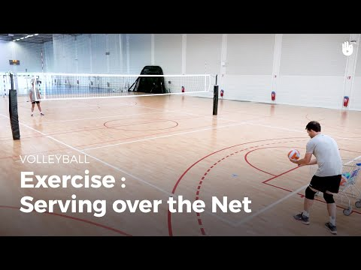
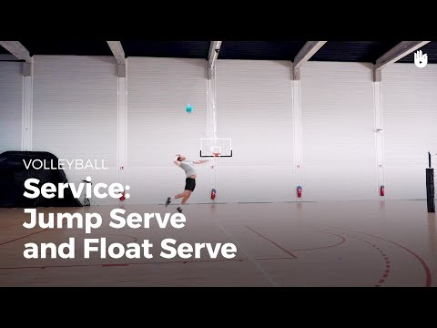
Skills:
Serving
Key Points to Remember:
Underhand Serve- Beginner
Step w/ Non-Dom. Leg
Close Fist Hit w/Dom Hand Under Ball
NO TOSS
Overhand Serve- Emerging
Hold ball in Non-Dom. Hand Away
Toss, Step w/ Non-Dom. Leg, Hit w/Dom. Hand
Strong, Open Hand
Hit Behind Ball
Freeze Arm after Contact
Jump Serve- Advanced

Slide 21
More Resources!!!
Different Offensive Strategies/Rotations
Skills and Drills
Watch Volleyball
4-2 Rotation
Serving
Serve Receive
Played Out Simulation
Elevate Yourself
The Art of Coaching Volleyball
Front Range Volleyball Club
Gold Medal Squared
AAU Volleyball Tournaments (12-19 years old)
NCAA Championships (College)
Volleyball World (FIVB)
5-1 Rotation
SD Volleyball
Conan Liu, M.D
Simulation w/ Real VB Game Clips
6-2 Rotation
SD Volleyball
Conan Liu, M.D
Simulation w/Real Game Clips

